Slide 1

STROKE PREDICTOR
An active participation of :
NITIN YADAV – 12019002001030
MD MAHFUZ ALAM - 12019002001019
Under the Supervision of
ASST. PROF. Ms. JYOTI KHANDELWAL
Dept. of Computer Science & Engineering
University of Engineering & Management, Jaipur

Slide 2
Outlines
Introduction
Literature Review
Objectives
Proposed Model
Experimental Setup
Result Analysis
Conclusion & Future Scope
Reference
Acknowledgement

Slide 3
Introduction
According to the World Health Organization (WHO) stroke is the 2nd leading cause of death globally, responsible for approximately 11% of total deaths.
A stroke occurs when the blood supply to part of your brain is interrupted or reduced, preventing brain tissue from getting oxygen and nutrients.
This dataset is used to predict whether a patient is likely to get stroke based on the input parameters like gender, age, various diseases, and smoking status. Each row in the data provides relevant information about the patient.

Slide 4
Literature Review
ABSTRACT
Proper data research in medical field has become an important element needed to engage healthcare sector . However, little research has been conducted to define the specific elements used in healthcare specially in prediction of strokes .
We attempt to review and consolidate data science on effective statistics on cause of strokes.
The intent is to find the exact data in the prediction of strokes nowadays as cases of strokes are increasing day by day.

Slide 5
Objectives
* Average age of person had stroke.
* Average Glucose level of person who had stroke and Average Glucose level of person who didn’t have stroke.
* Average persons who had stroke due to Heart Disease.
* Average BMI of people who had stroke.
* Chances of stroke of people from Urban and Rural Area.
* Chances of stroke due to smoking.
* Average of people who had stroke after marriage.
* Average of female who had Stroke and average of male had stroke due to Smoking.
* Average Male had stroke, Average Female had stroke.
* Average people who had stroke due to Hypertension.
* Chances of Stroke who have Hypertension, Heart Disease, Smoke.
* Chance of stroke according to Job Type.

Slide 6
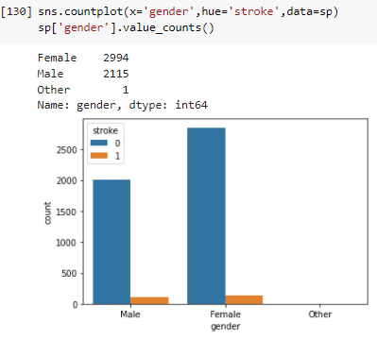
Proposed Model
PLANNING AND REQUIRED ASSETS
In order to make a good data science report on strokes prediction , some resources are very necessary . Managing data on time and accordingly is a important part of planning . Libraries should be looked on . We did research and found dataset on Kaggle.com best suited .
Pre-requisites :
Core knowledge of Python and its some strong Libraries.
Google Collab
Dataset.

Slide 7
Experimental Set-up
Google Colaboratory
Pandas
Seaborn
Numpy
Matplotlib
Scikit learn

Slide 8
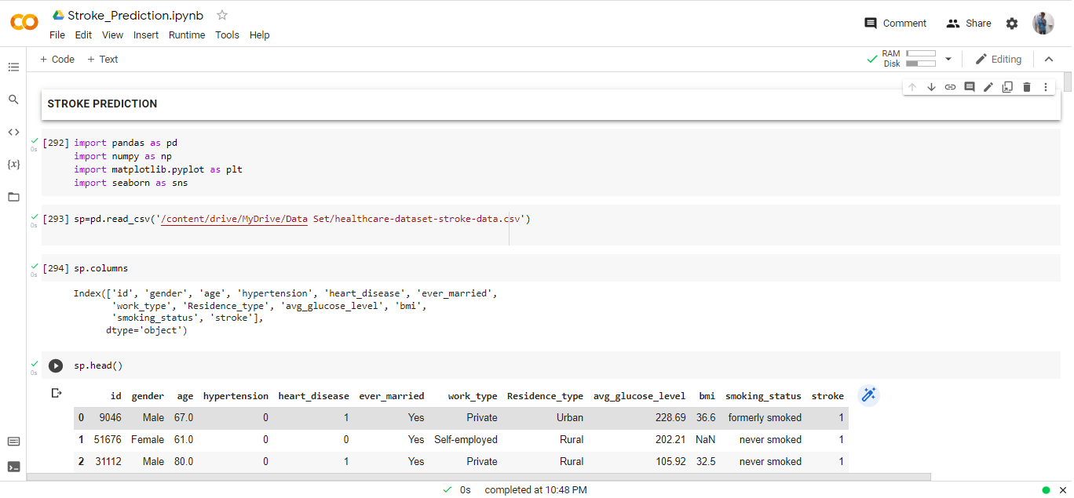
Experimental Set-up
Google Colab

Slide 9
Result Analysis
* So, we can conclude that people who have age greater than 65 have more chances of having stroke.
* We can convey that Heart Disease can be considered as a minor factor as 17% had stroke and who had Heart Disease.
Through this data Smoking cannot be considered as a cause for Stroke
There is slight chances of NOT having Stroke if you are Unmarried
We did have more number of data in Females and still found they have 0.9% more chances to have a Stroke.

Slide 10
Limitation
Limitation of the project are-
* Since this model is very good in predicting the chances of having stroke but there is slight chances 0f approx.. 10% that the prediction could be wrong .
* As this model depends on a particular dataset and this model does not do prediction on real time data.

Slide 11
Conclusions & Future Scope
This Prediction Model is playing an important part in Prediction of Stroke.90% of the Prediction is correct . Static Model also have their own place for the platform where there is specific information required. Static Prediction Model require less investment as compare to dynamic Model. our Prediction provide a better dynamic view and instant information . In future , looking forward to make changes in this to improve the user interaction and make it more user friendly and fully designed .

Slide 12
References
Kaggle.: . https://www.kaggle.com/
GeekForGeeks.: https://www.geekforgeeks.com
* Google Colab.: https://research.google.com/colaboratory/

Slide 13
Acknowledgement
The endless thanks goes to Lord Almighty for all the blessings he has showered onto us, which has enabled us to write this last note in our project work. During the period of our project research, as in the rest of our life, We have been blessed by some extraordinary people who have spun a web of support around us. We would like an attempt to thank them for making time during our project research. We are thankful to our research supervisor, Asst. Prof. Ms. Jyoti Khandelwal to providing the help needed. Each meeting with him added in valuable aspects to the implementation and broadened my perspective. He has guided us with his invaluable suggestions, and encouraged us a lot in the academic life.

Slide 14

Dept. of CSE, University of Engineering & Management Jaipur

